Slide 1
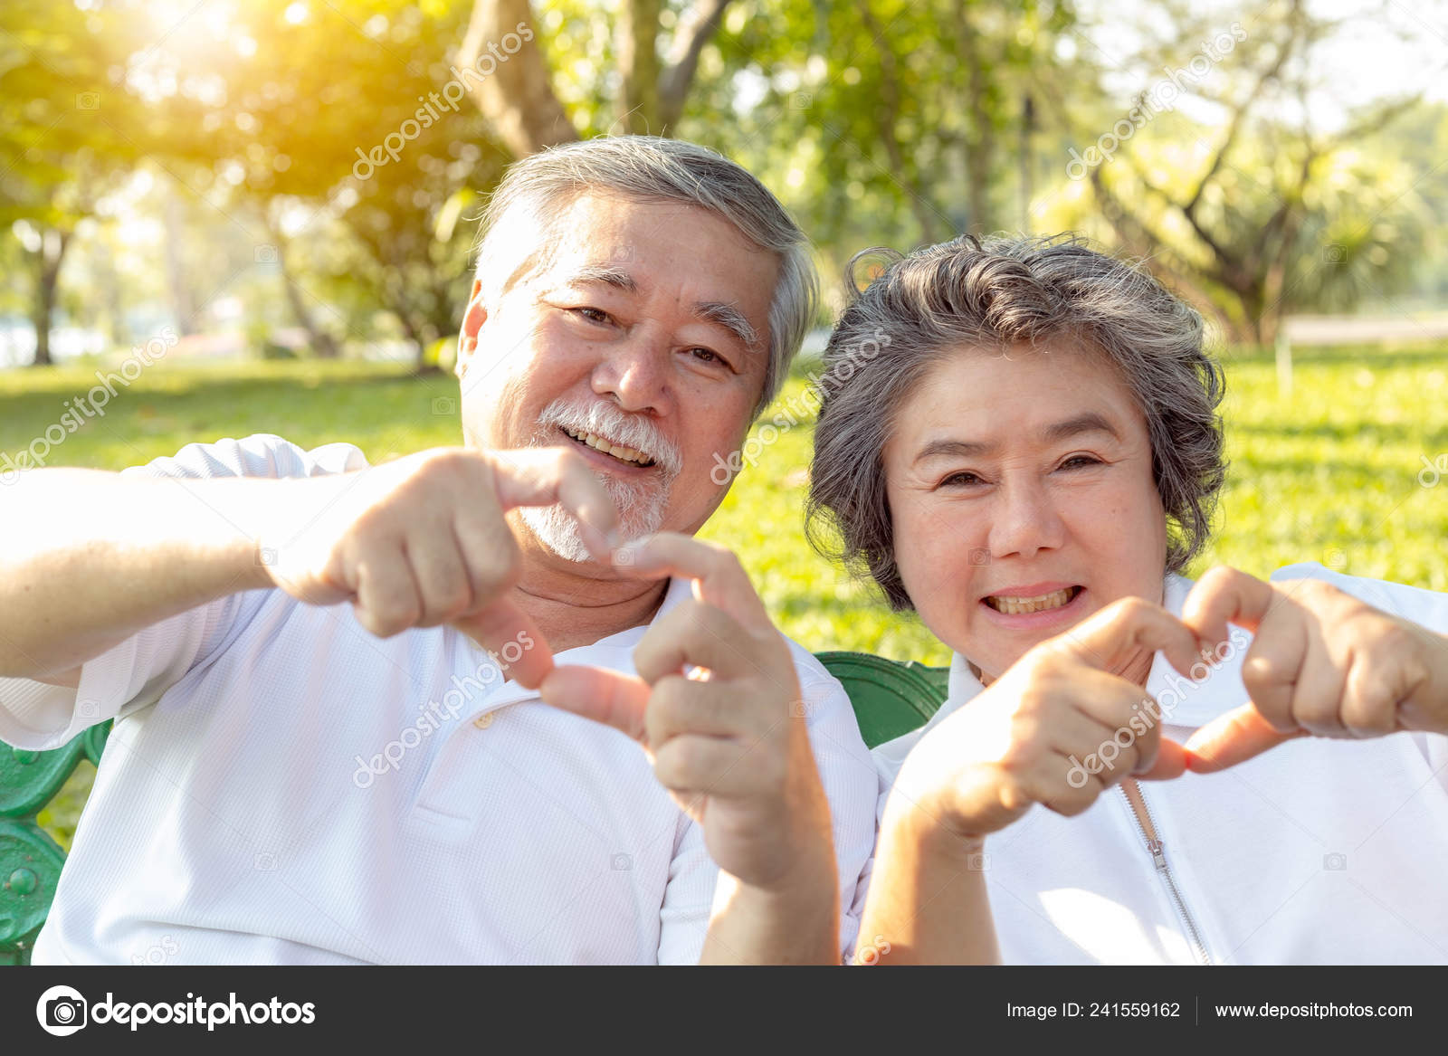


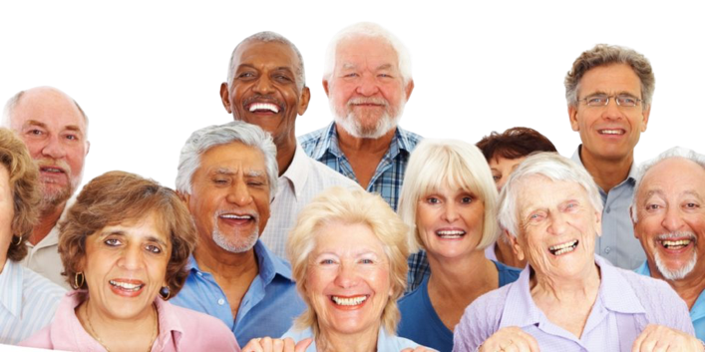
WE HELP YOU SMILING,
FIND THE BUDDIES,
CONNECT TOGETHER.
?

Slide 2

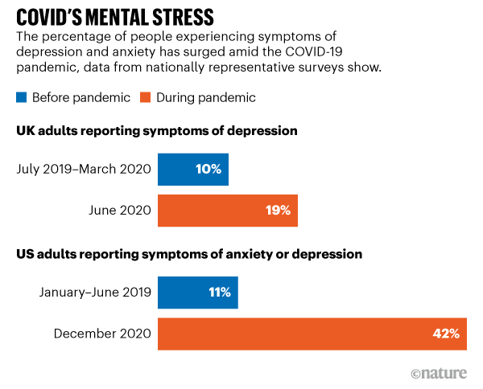
Technological
Gap
“Accessibility”
Mental
Health Care
Multicultural
Society
Lack of technological support for elder people
Community app to be together
Having Sense of global belonging

Slide 3
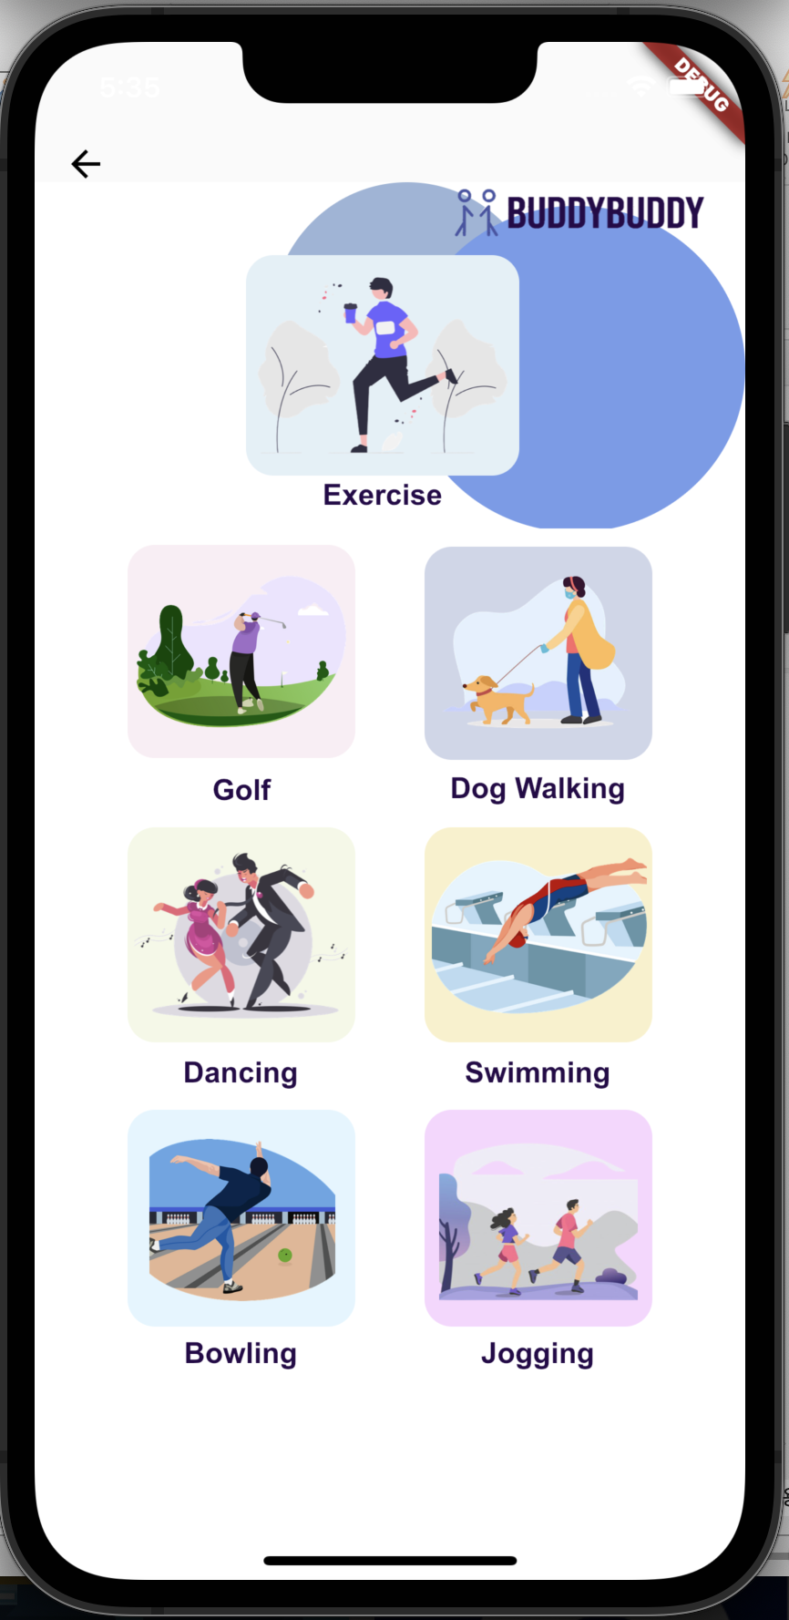
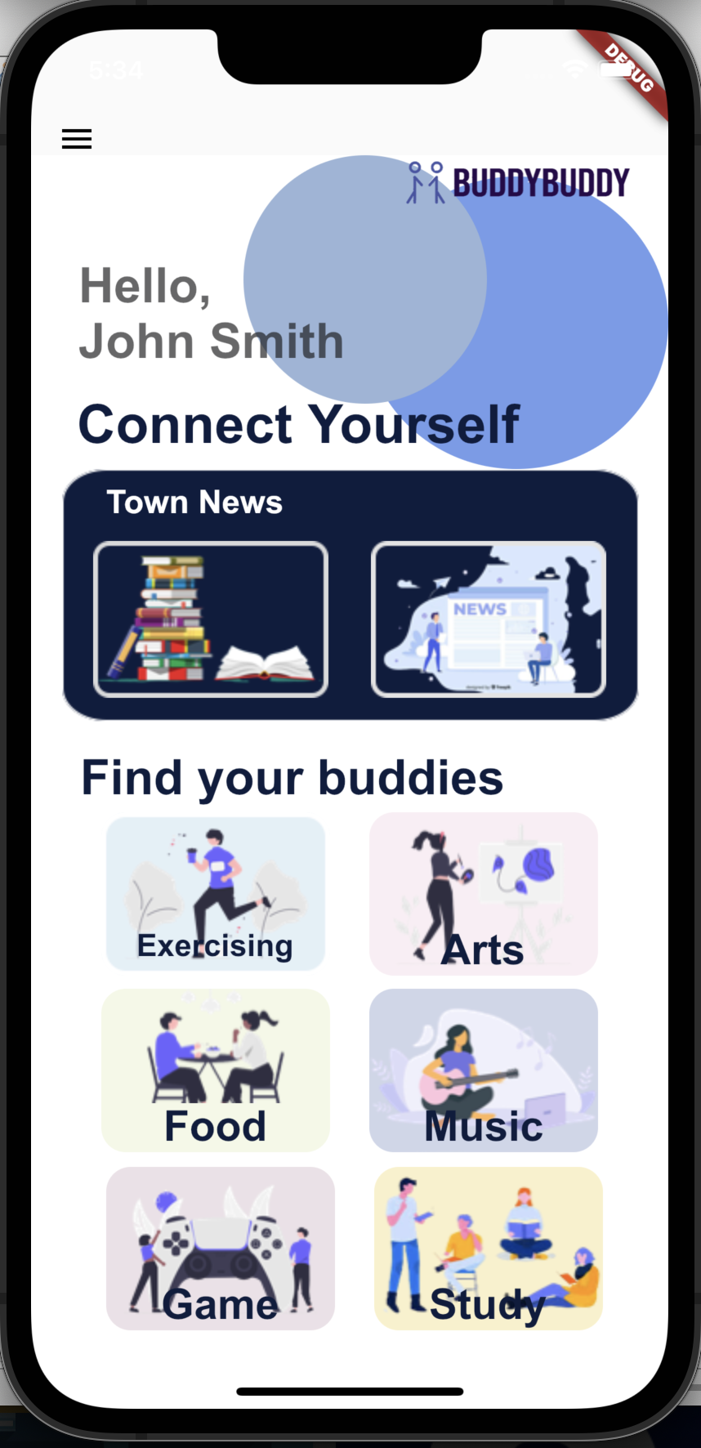
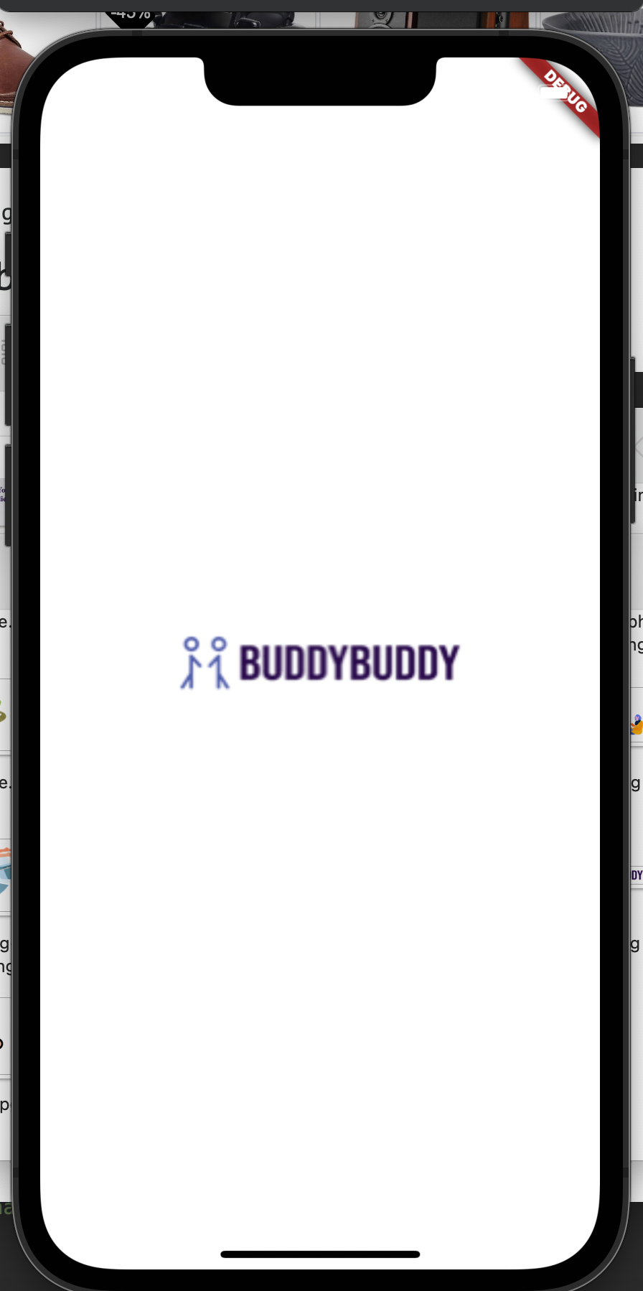

Connect / Coexistence / Enjoy

Slide 4

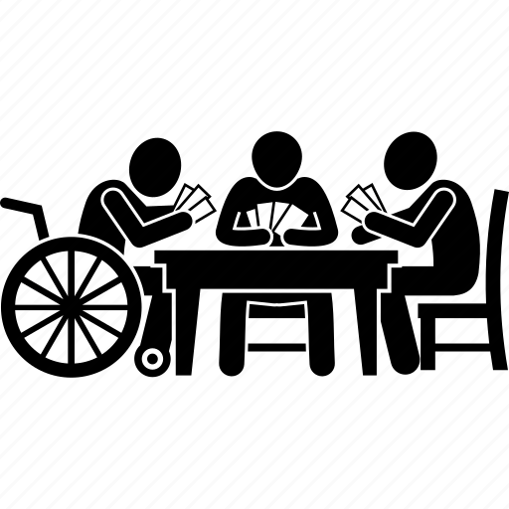



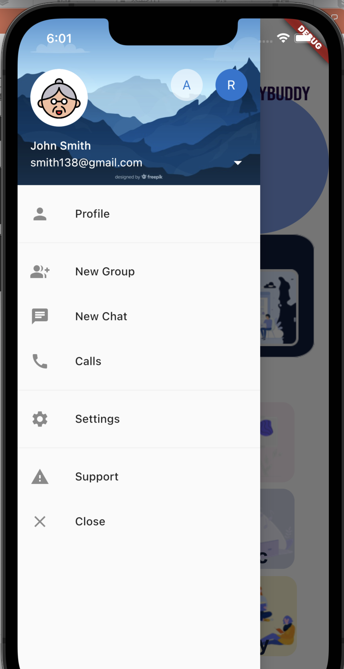
Elder-Friendly Design
Easy Access
No verification
ID auto generation
Visualized Design
Less text
Icon Based
Get-Together
Active Community
Accessibility
Navigation
Connection
1. Log in without regulation
2. Choose activities you want to play
3. Find buddies with similar interests

Slide 5
Connect / Coexistence / Enjoy

Slide 6





Tech Stack

Slide 7
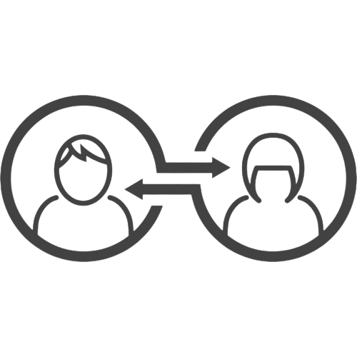

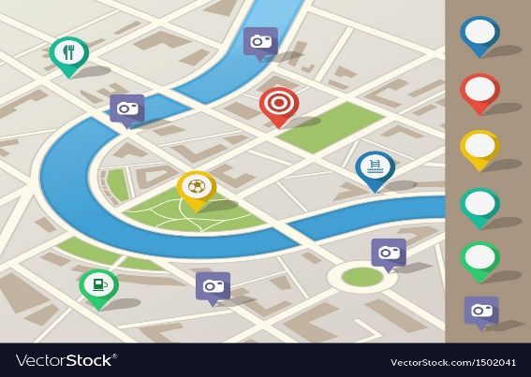
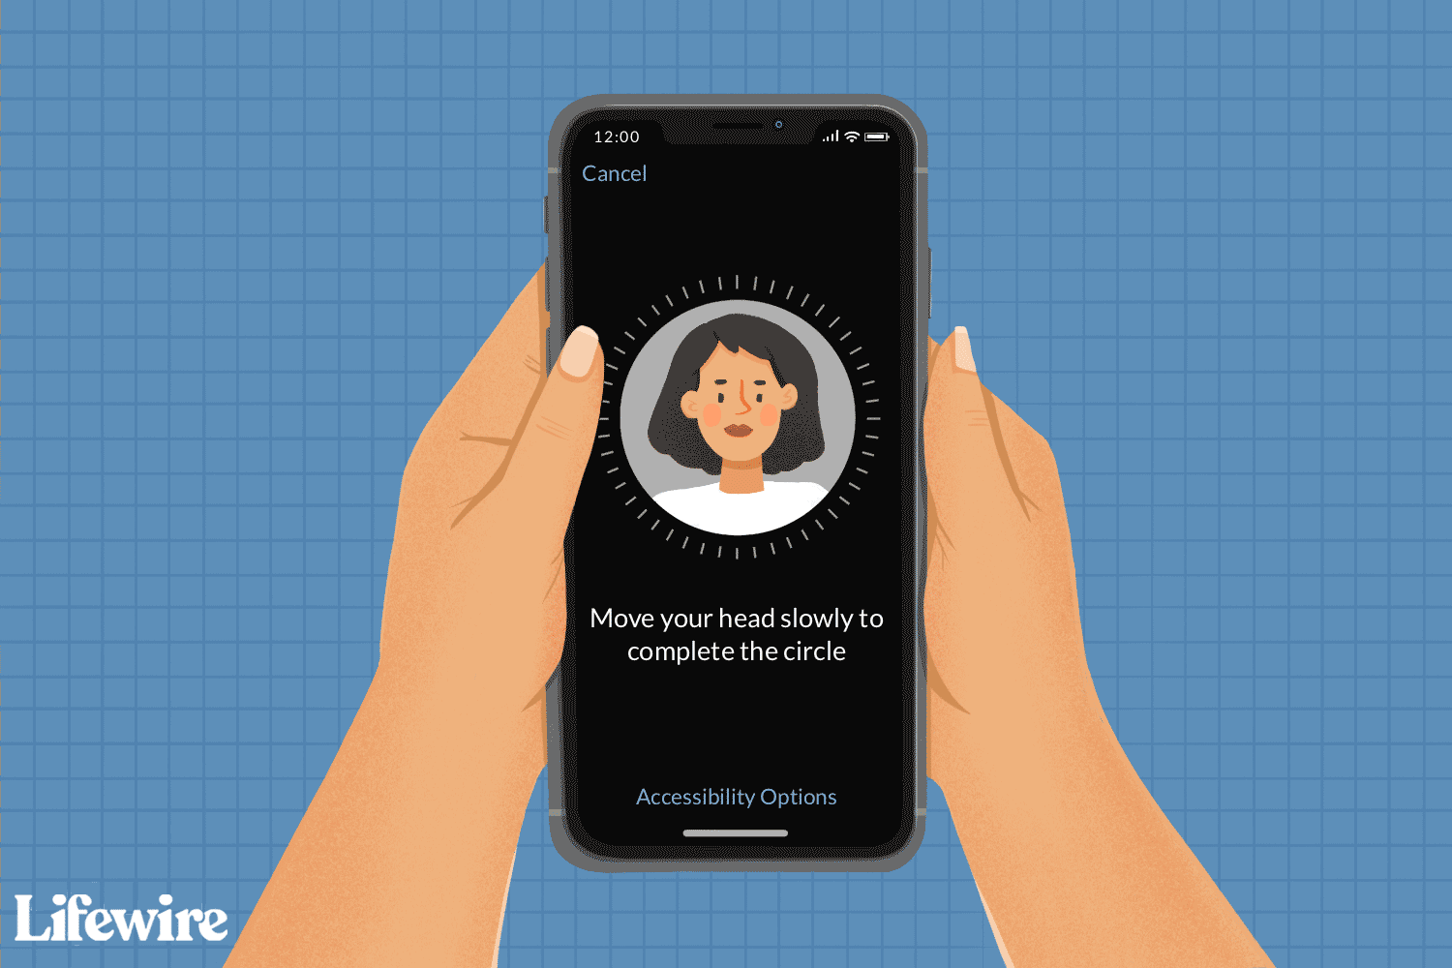

Future Development
Auto-match service
by AI
Map - Navigation
Web Crawling
Face ID

